Slide 1
AML Digital Twins
Shmulevich Lab
https://reporter.nih.gov/project-details/11492240#details

Slide 2
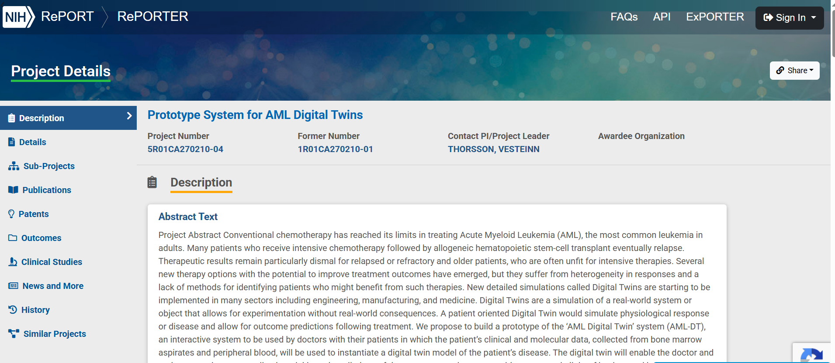

Slide 3
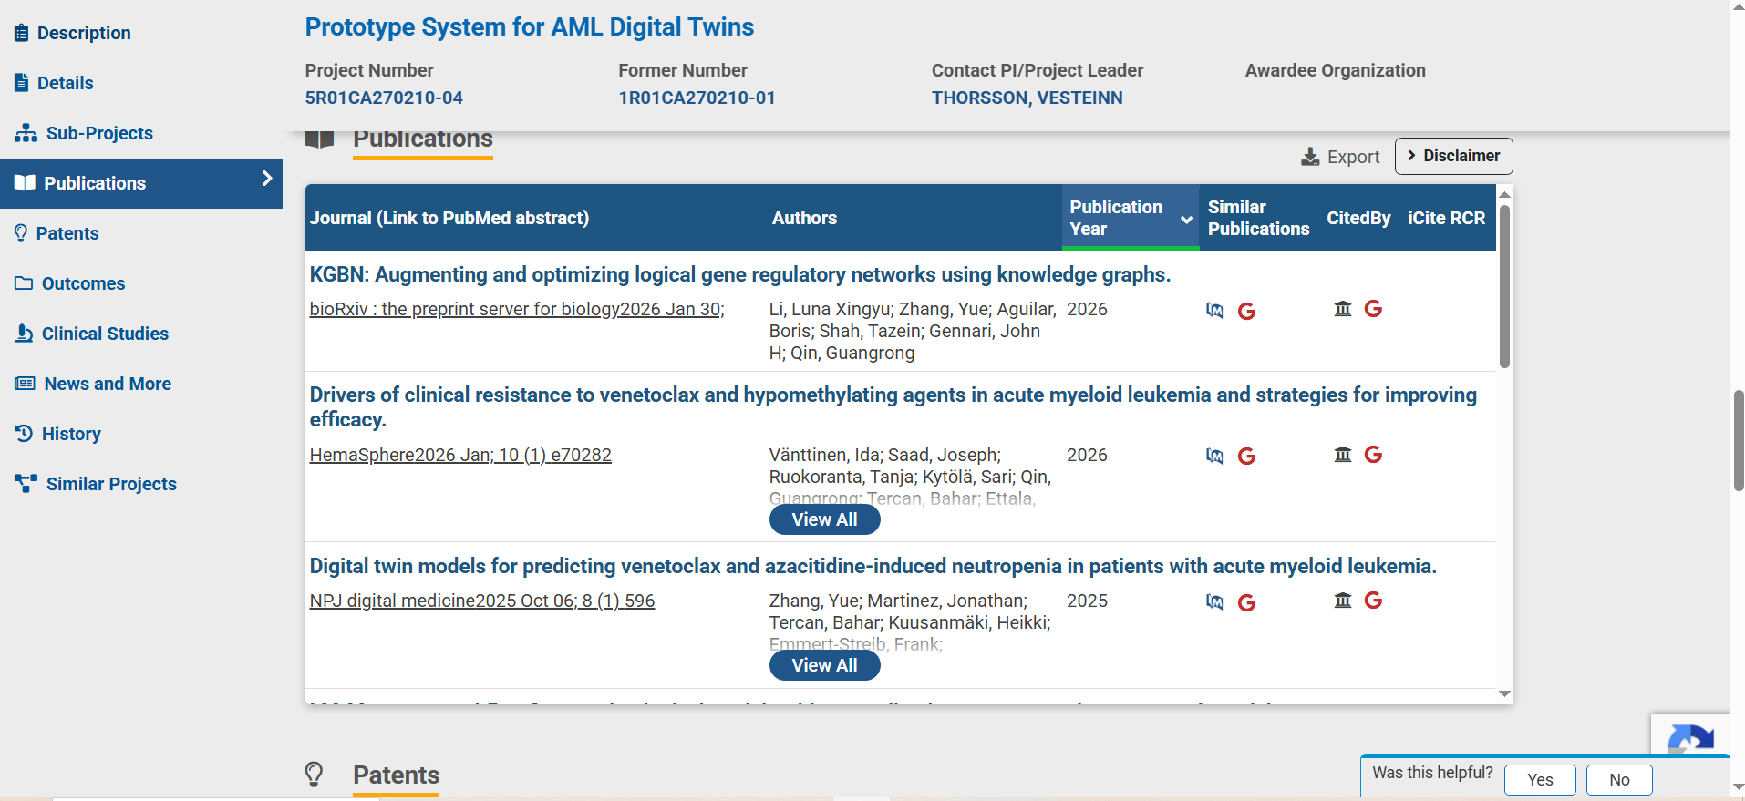

Slide 4
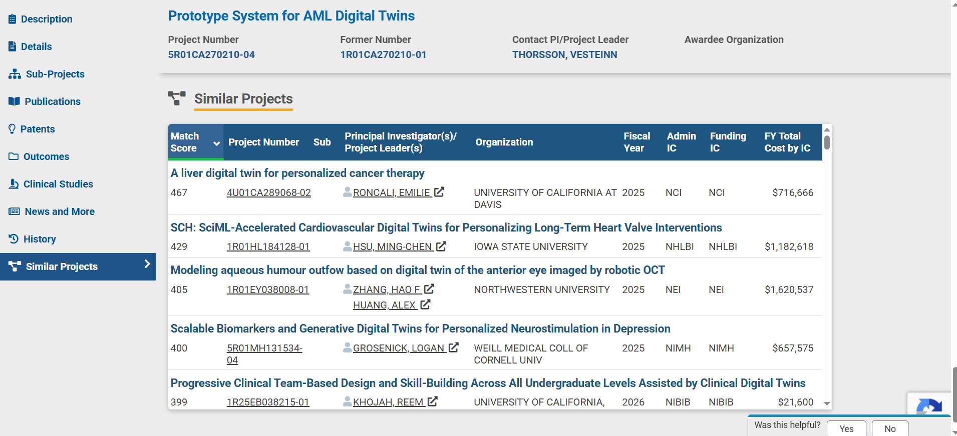

Slide 5
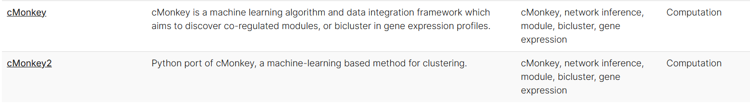
Relevant Projects with Publicly Available Software/Framework
https://isbscience.org/software-downloads/

Slide 6
